Slide 1




Data Lab
Rui Benfeitas 11/11/2019
@ruifeitas
benfeitas

Slide 2
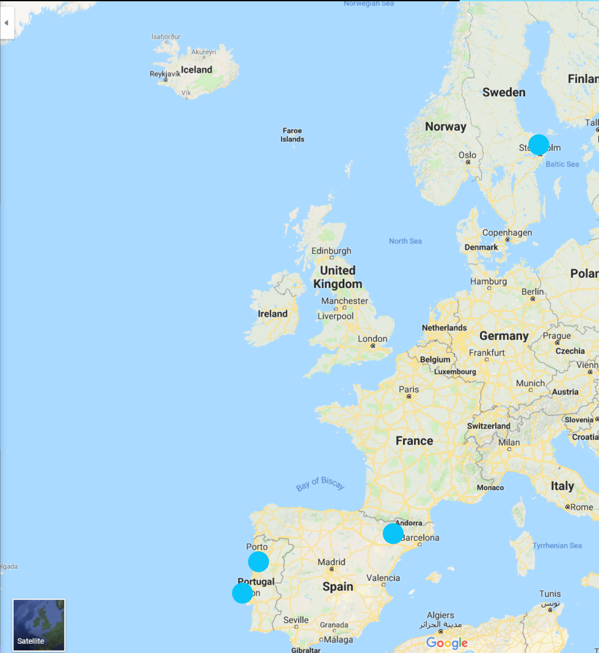
Who am I?
School:
Science! Bio?Maths?Chem?
University:
Bio! Molecular?Ecology?
University (+):
Biochemistry! Study what?
University (++):
Computational Bio
University (+++):
Bioinformatics

Slide 3
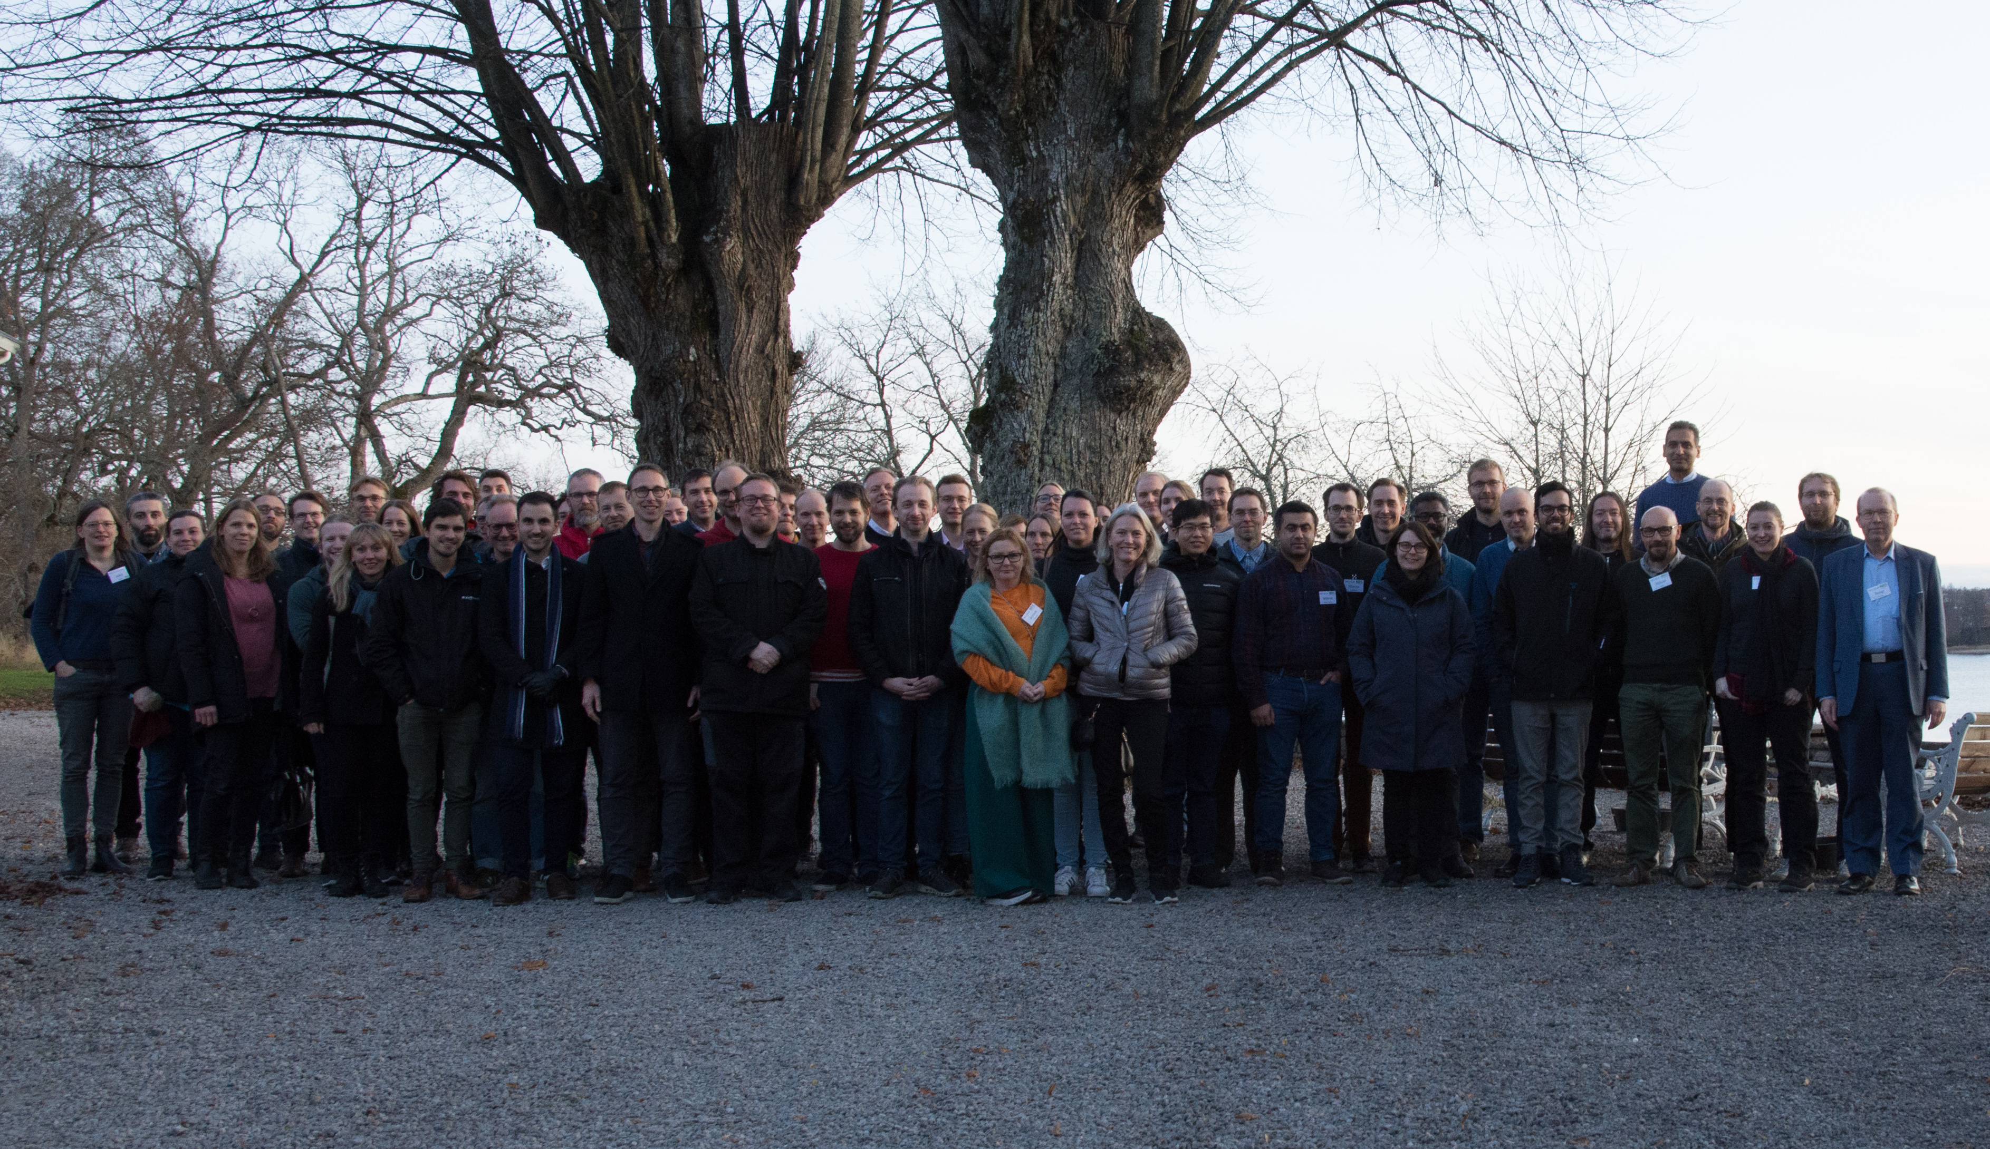


Slide 4
Human genome sequenced in 2003, took 20 years

Slide 5
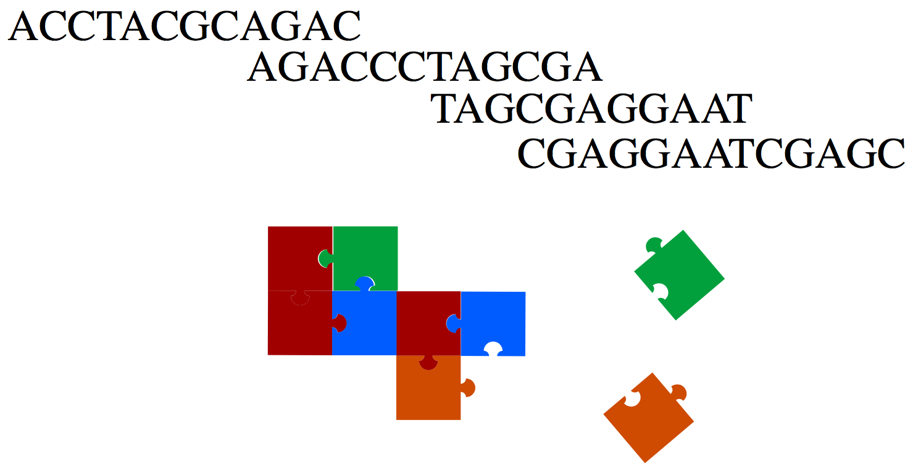
Bioinformatics

Slide 6
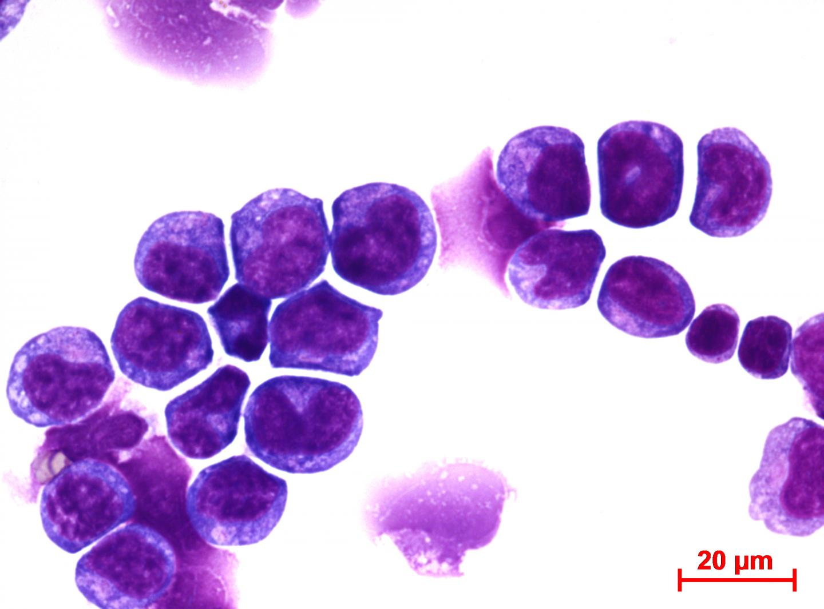
Cancer

Slide 7
Cancer
What is so special about these cells?
understand the biology
develop drugs

Slide 8
biology
physics
chemistry
informatics
understand cancer
new drug targets

Slide 9
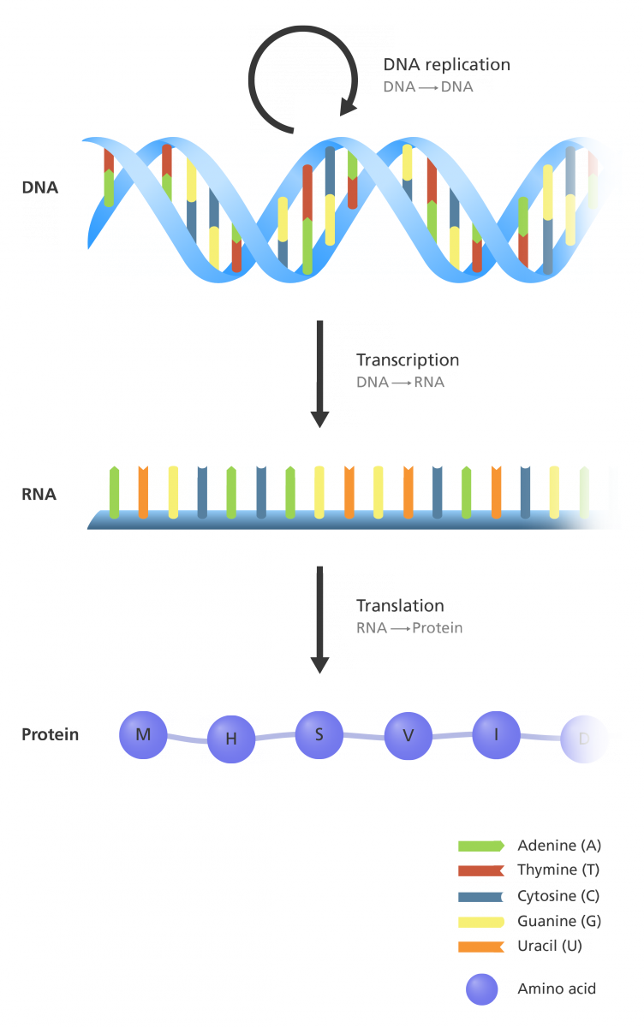
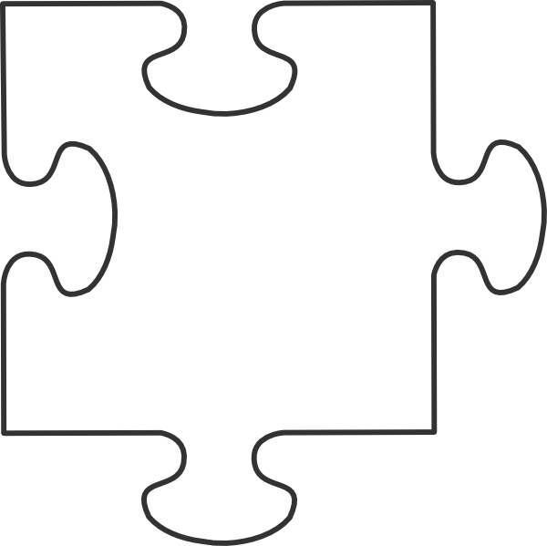

Slide 10
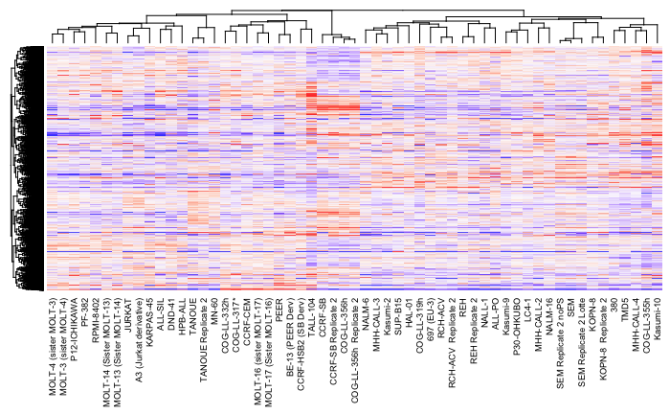
patients
genes

Slide 11
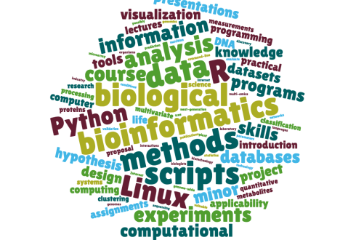

Slide 12
What is a programming language?

Slide 13
(Bio)informatician’s best friend:
Google

Slide 14
Lesson plan
Lesson 1: Intro to bioinformatics and Python
Lesson 2: Introduction to Data Analysis
Lesson 3: Introduction to genomics

Slide 15
What do we need?
Form groups
Computer
Internet connection
Google account

Slide 16
Let’s start
Go to:
researchschool.github.io/researchschool/
or
tiny.cc/researchschool

Slide 17
Let’s learn Python!

